Slide 1
MECHANICAL ASPHYXIA
DR.S.SANJU
ASSISTANT PROFESSOR
DEPT. OF FORENSIC MEDICINE AND TOXICOLOGY

Slide 2
HANGING
CLASSIFICATION - BASED ON
1.DEGREE OF SUSPENSION
COMPLETE HANGING
INCOMPLETE HANGING
2. POSITION OF KNOT
TYPICAL
ATYPICAL
3. INTENT
SUICIDAL,HOMICIDAL,ACCIDENTAL,AUTOEROTIC

Slide 3
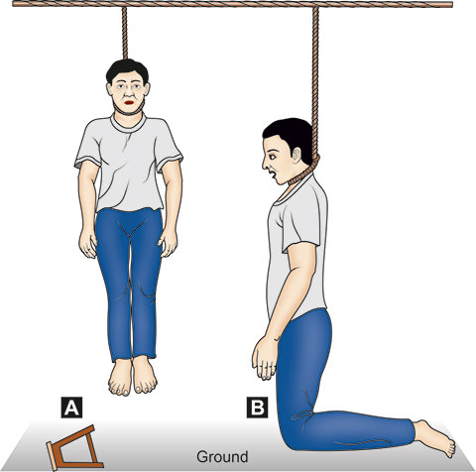
HANGING

Slide 4
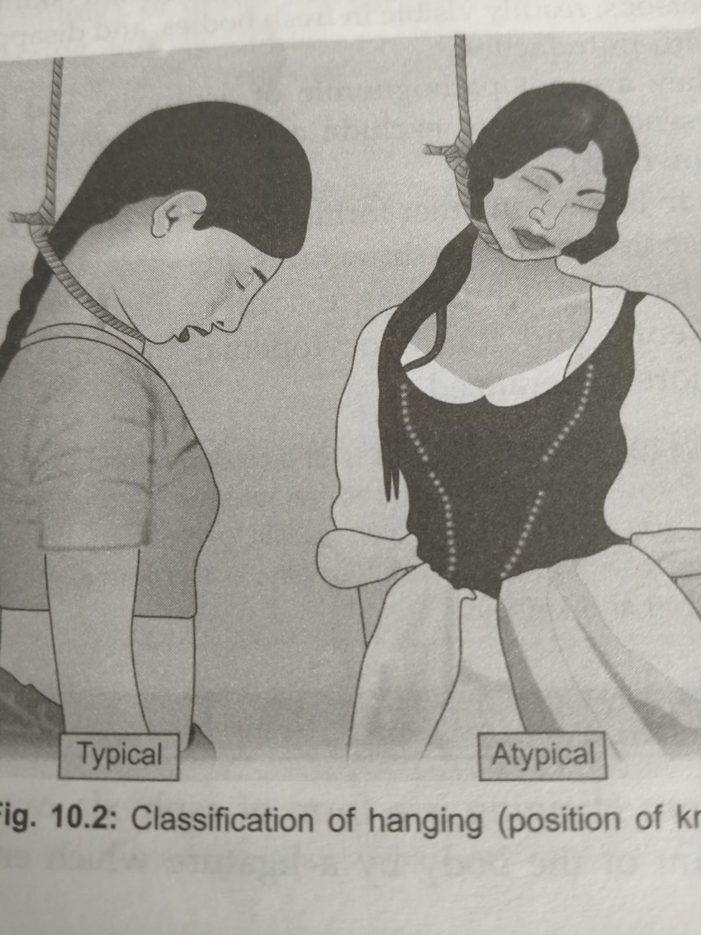

Slide 5
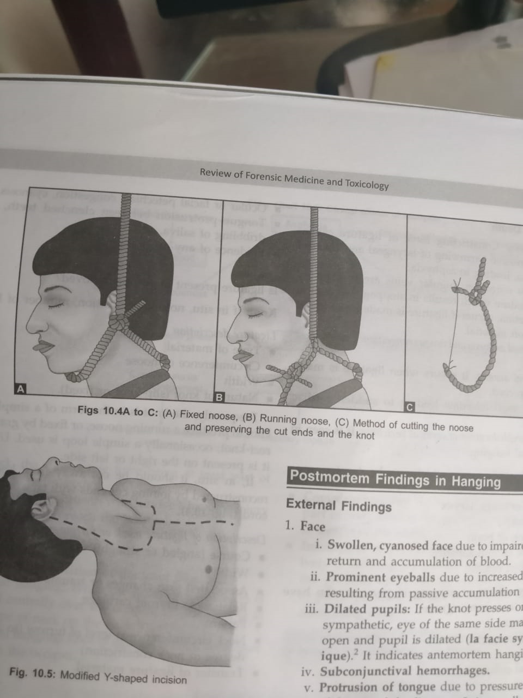

Slide 6
CAUSE OF DEATH
1.Asphyxia
2.Venous congestion
3.Combined Asphyxia and Venous congestion
4.Cerebral Anaemia
5.Reflex Vagal inhibition
6.Fracture /Dislocation of cervical vertebrae

Slide 7
CAUSE OF DELAYED DEATH
Aspiration Pneumonia
Edema of lungs
Infections
Infarction of Brain
Hypoxic encephalopathy
Abscess of brain

Slide 8
SECONDARY EFFECTS
Hemiplegia
Epileptiform convulsions
Amnesia
Cervical Cellulitis
Parotitis
Retropharyngial abscess

Slide 9
PM FINDINGS
1.FACE
2.NECK
3.OTHER PARTS OF THE BODY

Slide 10
FACE
Swollen ,cyanosed face
Prominent eyeballs
Dilated pupils(la facie sympathetique)
Subconjuntival Haemorrhage
Protrusion of tongue
Bleeding from nose and ears
Lips and mucous membrane of mouth are blue
Dribbling of saliva

Slide 11
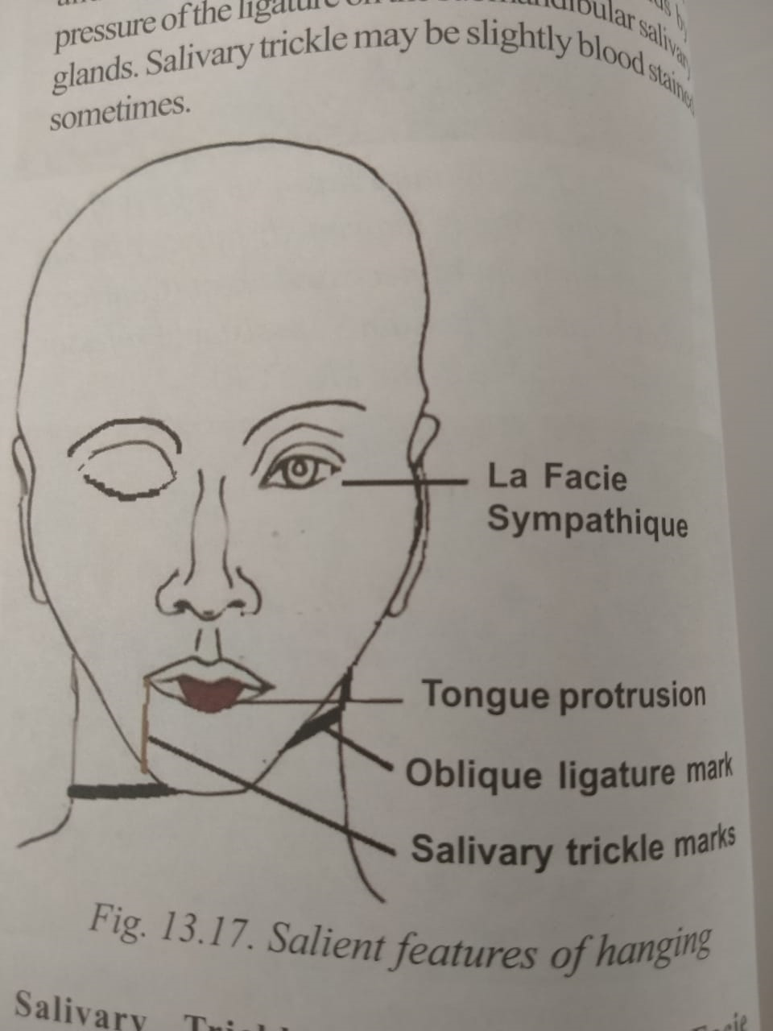

Slide 12
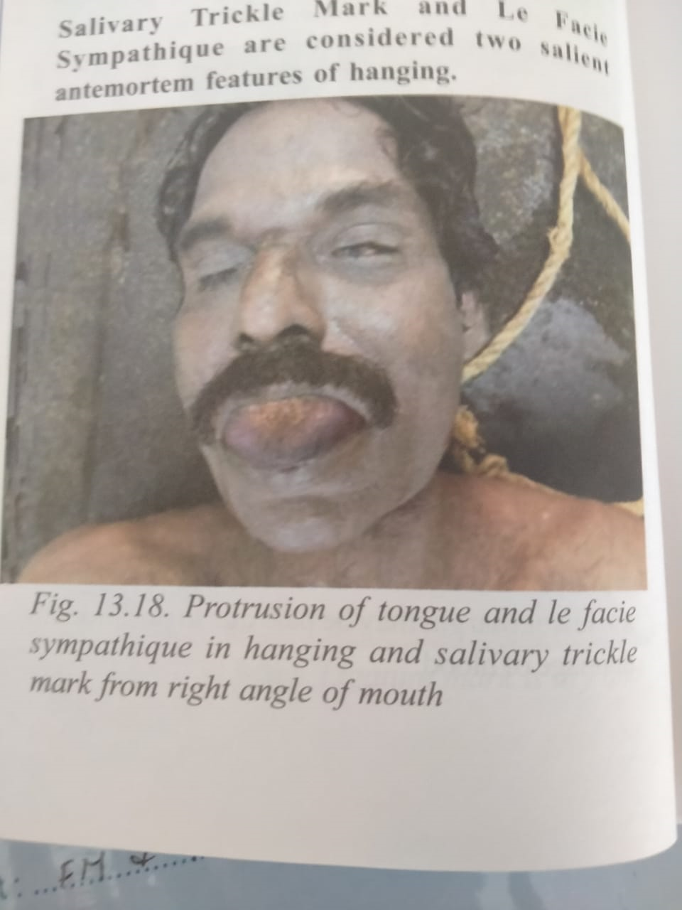

Slide 13
NECK
LIGATURE MARK
i.Site
ii.saize/Shape
iii.Direction
iv.Skin at the site
DIMENSION OF NECK
BENDING OF NECK

Slide 14
OTHER PARTS OF BODY
Tardieu spots
Cyanosis of finger nails
Purple coloured postmortem staining in the lower limbs and lower regions of upperlimbs(hands/forearms) – glove and stocking PM Staining
Hands are clenched
In males ,there may be penile turgidity & involuntary discharge of semen
Involuntary discharge of fecal matter and urine

Slide 15
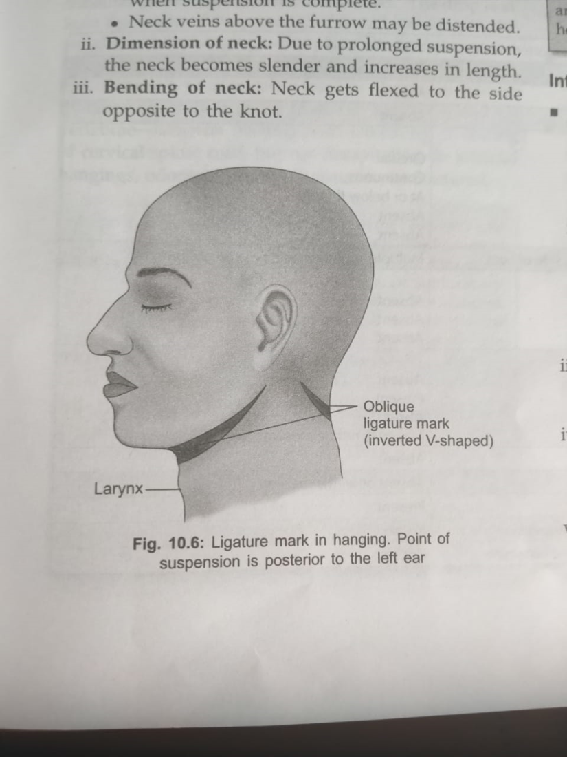

Slide 16
AM AND PM HANGING
FEATURE | ANTEMORTEM | POSTMORTEM
Salivary dribbling | Present | Absent
Fecal/Urinary stains | May be presaent | Absent
Ligature mark Direction Continuity Level in the neck Parchmentation Vital reaction | Oblique Non continuos Above thyroid Present Present | Circular Continuos At or below thyroid Absent Absent
Knot | Single,simple on one side of neck | Multiple,granny or reef type on occiput,chin

Slide 17
AM AND PM HANGING
FEATURE | ANTEMORTEM | POSTMORTEM
Pm staining | present | present
Evidence of injury
Elongation of neck | present | Absent
Cyanosis | Deeply present | Faintly or absent
Histochemistry of ligature mark | Increased serotonin and histamine | Not so

